Slide 1
Cloud Native Architecture
Pravin Y Pawar

Slide 2
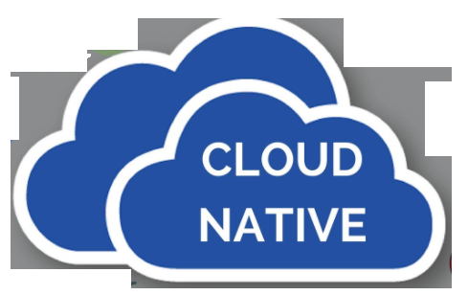
Introducing cloud-native software
New Edge Applications Demands
Needs to be up, software available 24/7 for 365 days
Need to be able to release frequently to give users the instant gratification
Needs to take care of the mobility and always-connected state of users drives
Requires new storage and processing approaches for connected devices (“things”) that form a distributed data fabric of unprecedented size
These needs have led directly to the emergence of a new architectural style for software:
cloud-native software!

Slide 3
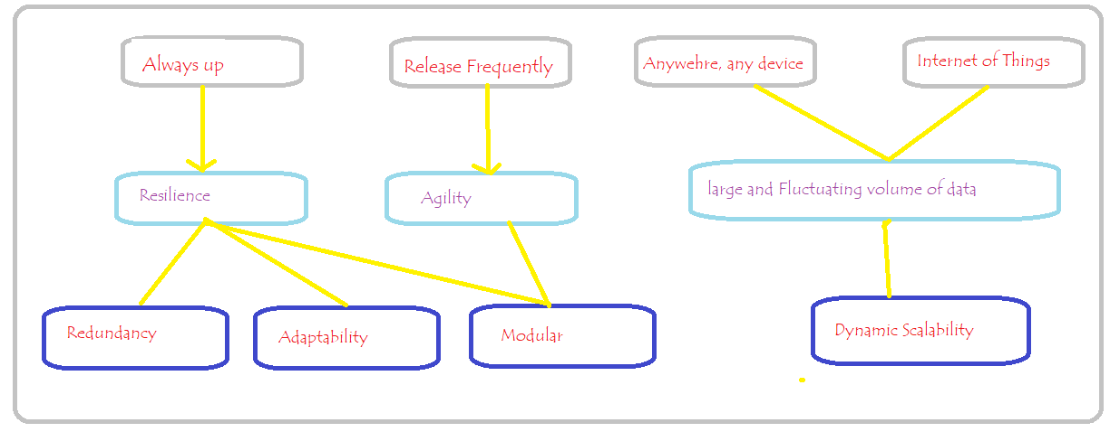
User requirements for software
What characterizes cloud-native software?

Slide 4
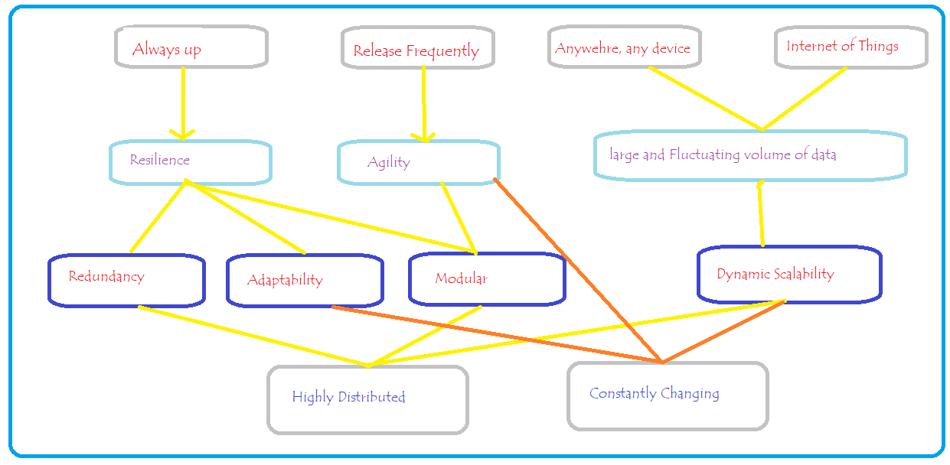
Architectural and management tenets
What defines “cloud native” software?

Slide 5
Defining “Cloud Native”
Two important Characteristics
Deployment
Software that’s constructed as a set of independent components, redundantly deployed, implies distribution
Redundant copies were all deployed close to one another, be at greater risk of local failures
Make efficient use of the infrastructure resources while deploying additional instances of an app
from cloud services such as AWS, Google Cloud Platform (GCP), and Microsoft Azure
As a result, you deploy software modules in a highly distributed manner
Adaptable software
“able to adjust to new conditions,” and the conditions are those of the infrastructure and the set of interrelated software modules
intrinsically tied together: as the infrastructure changes, the software changes, and vice versa
Frequent releases mean frequent change
adapting to fluctuating request volumes through scaling operations represents a constant adjustment
Clear that software and the environment it runs in are constantly changing
Cloud-native software is highly distributed, must operate in a constantly changing environment, and is itself constantly changing.

Slide 6
Thank You!
Reference:
Cloud Native Patterns by Cornelia Davis
In our next session:

